Slide 1
Object-Oriented Software Engineering
Chapter 5:
Modelling with Classes
Part 2

Slide 2

Association classes
Sometimes, an attribute that concerns two associated classes cannot be placed in either of the classes.
Imagine the association shown in Figure below, in which a student can register in any number of course sections, and a course section can have any number of students.
In which class should the student’s grade be put?
Put the grade in the Student class, then a student could have only one grade, not one per course section.
If in the CourseSection class, then a course section could have only one grade, not one per student.
Chapter 5: Modelling with classes

Slide 3
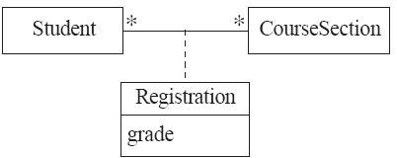
Association classes
The grade is therefore not a property of either class.
The solution to this problem is to create an association class to hold the grade.
An association class is connected to its association by a dashed line.
an association class should be named using a noun that reflects the
  meaning of the association; the association name is then no longer needed.
Chapter 5: Modelling with classes

Slide 4

Association classes
  Aside from being attached to an association, an association class is no different from any other class.
  In particular, it can have subclasses and other associations connected to it.
Open in Umple and extended example
Chapter 5: Modelling with classes

Slide 5
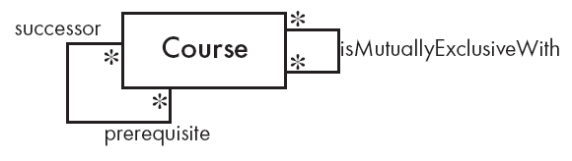
Reflexive associations
  It is possible for an association to connect a class to itself
  A course can require other prerequisite courses to be taken first.
  If two courses cover nearly the same material, taking one of them
  may preclude a student from taking the other, and vice versa – such courses are said to be mutually exclusive.
  The first association is asymmetric, since the roles of the classes at each end are clearly different.
  The second, on the other hand, is symmetric. To make the meaning clear, you should label an asymmetric reflexive association using role names instead of an association name.
Open in Umple
Chapter 5: Modelling with classes

Slide 6

Directionality in associations
Associations are by default bi-directional
It is possible to limit the direction of an association by adding an arrow at one end
Figure shows two classes that might exist in a calendar application. The user of this application can associate any number of written notes with any day.
An instance of class Day would need to know about the instances of Note associated with it…
Open in Umple
Chapter 5: Modelling with classes

Slide 7
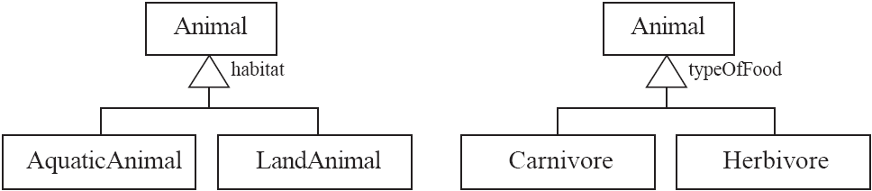
5.4 Generalization
Specializing a superclass into two or more subclasses
  A generalization set is a labelled group of generalizations with a common superclass
  The label (sometimes called the discriminator) describes the criteria used in the specialization
  The label of a generalization set will typically be an attribute that has a different value in each subclass.
Chapter 5: Modelling with classes

Slide 8
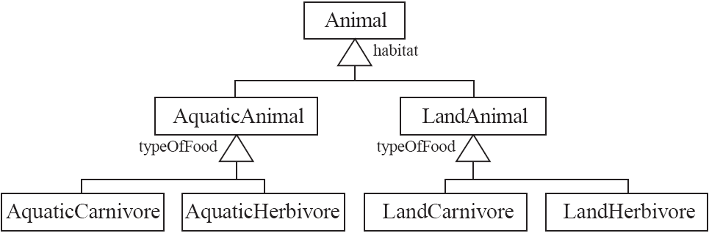
Handling multiple discriminators
  If you were to include both generalization sets in the same model then a problem would arise in implementation environments such as Java
  One solution, shown in figure, is to create a higher-level generalization
Chapter 5: Modelling with classes

Slide 9
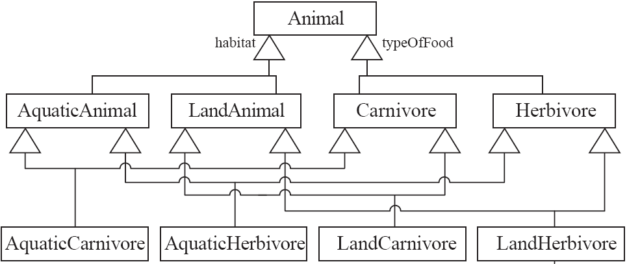
Handling multiple discriminators
  Another possible solution, using multiple inheritance.
Chapter 5: Modelling with classes

Slide 10
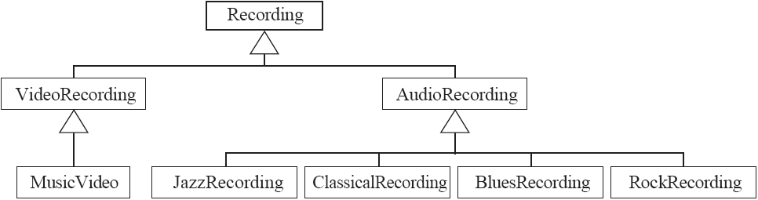
Avoiding unnecessary generalizations
A common mistake made by beginners is to overdo generalization.
Figure shows a taxonomy of different types of products that might be sold by a music store.
Justify the existence of each class, there must be some operation that will be done differently in that class.
Inappropriate hierarchy of classes, which should be instances
Chapter 5: Modelling with classes

Slide 11
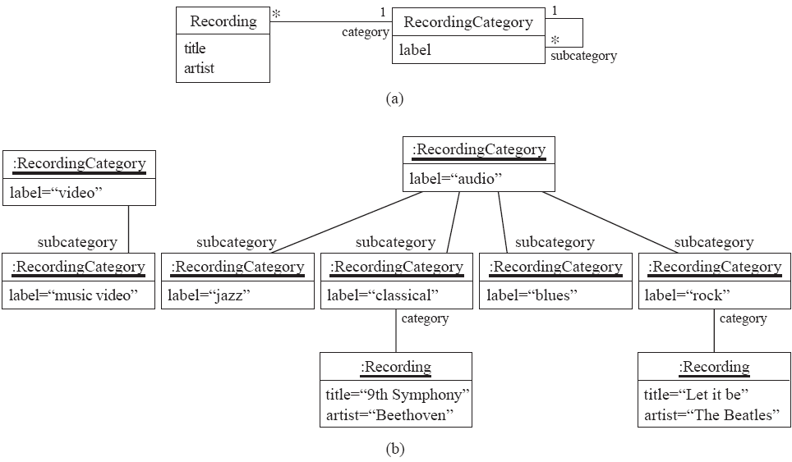
Avoiding unnecessary generalizations (cont)
Improved class diagram, with its corresponding instance diagram.
Most of the classes now become instances of Recording Category, and the hierarchy itself becomes a hierarchy of instances, as shown in Figure (b).
Chapter 5: Modelling with classes

Slide 12
Exercises
Draw a class diagram corresponding to the following situation.
An organization has three categories of employee: professional staff,
technical staff and support staff. The organization also has departments
and divisions.
Chapter 5: Modelling with classes

Slide 13
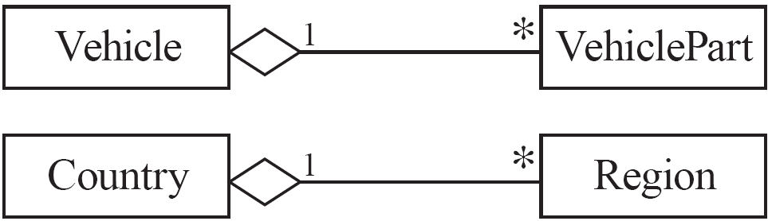
More Advanced Features: Aggregation
  Aggregations are special associations that represent ‘part-whole’ relationships.
    The ‘whole’ side is often called the assembly or the aggregate
    aggregations are specified using a diamond symbol, which is placed next to the aggregate.This symbol is a shorthand notation association named isPartOf
Chapter 5: Modelling with classes

Slide 14
When to use an aggregation
As a general rule, you can mark an association as an aggregation if the following are true:
  You can state that
    the parts ‘are part of’ the aggregate
    or the aggregate ‘is composed of’ the parts
Chapter 5: Modelling with classes

Slide 15

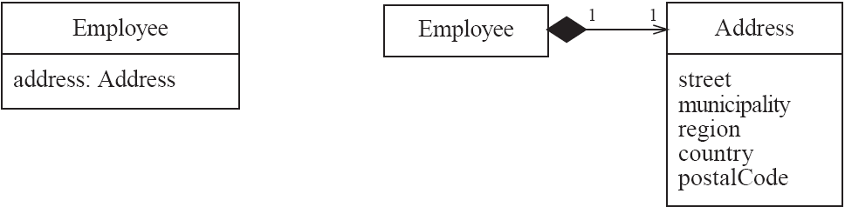
Composition
  A composition is a strong kind of aggregation
    if the aggregate is destroyed, then the parts are destroyed as well
  Two alternatives for addresses. Figure illustrate a situation where an attribute has been expanded into an associated class.
Chapter 5: Modelling with classes

Slide 16
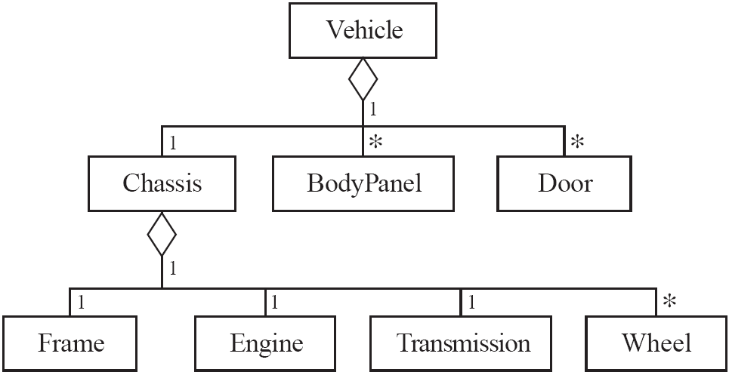
Aggregation hierarchy
Chapter 5: Modelling with classes

Slide 17
Exercise
For each of the following associations, indicate whether it should be an ordinary association, a standard aggregation, or a composition.
    A telephone and its handset.
    A book and its chapters.
Chapter 5: Modelling with classes

Slide 18
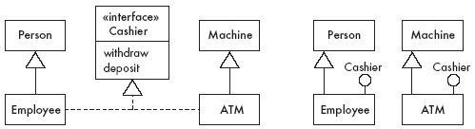
Interfaces
  An interface is similar to a class, except it lacks instance variables and implemented methods
  In UML, there are two ways to specify interfaces
Chapter 5: Modelling with classes

Slide 19
Notes and descriptive text
  Descriptive text
    Embed your diagrams in a larger document
    Text can explain aspects of the system
    Highlight and expand on important features
  Notes:
    A note is a small block of text embedded in a UML diagram
    It acts like a comment in a programming language
  Constraint:
    A constraint is like a note, except that it is written in a formal
    Language. The recommended language is Object Constraint Language (OCL).
Chapter 5: Modelling with classes

Slide 20
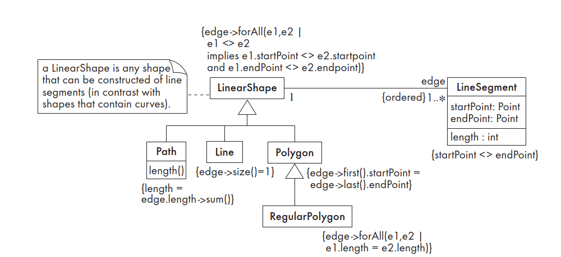
Chapter 5: Modelling with classes

